Slide 1
RECURRENT NEURAL NETWORKS:

Slide 2
Feedforward Network
A trained feed forward network can be exposed to any random collection of inputs, therefore not following any order.
In feedforward networks, the relationship between the input and the output can be expressed as a static function.
Output at time t is independent of output at time t-1.
But sometimes predicting an output requires its previous output.
Understanding a sentence needs understanding of its previous sentence(s).

Slide 3
Recurrent Neural Network(RNN)
The network we have encountered so far are known as feedforward networks since they have no loops in them.
But loops are more common in the brain.
Hopfield network is a simple neural network model that has feedback connections and present a model of human memory, known as an associative memory.
RNN is a type of Neural Network where the output from previous step are fed as input to the current step.

Slide 4
RECURRENT
Unlike feedforward neural networks, RNNs can use their internal state (memory) to process sequences of inputs.
In RNN, self-loops and backward connections between the nodes are allowed.
Single layer RNN and multilayer RNN.

Slide 5
HOPFIELD NETWORK
A Hopfield network is a single layer recurrent ANN popularized by John Hopfield in 1982.
The recurrent network performs sequential updating process.
Hopfield nets serve as CAM systems with binary threshold nodes.
Two versions of the network: Discrete and Continuous
Hopfield
Hopfield networks classify binary pattern vectors.

Slide 6


x_{n}
x₂
x₁
^{w}n1
^{w}21
-1
θ₁
y_{n} y₂
y₁
Every pair of units i and j in a Hopfield network have a connection
No self feedback, w_{ii}=0 and weights are symmetric, w_{ij} = w_{ji}
Each node has an external input and threshold θ_{j}, j = 1…n
described by the weight w_{i j}.

Slide 7
How to "train" a Hopfield network
The constraint that weights be symmetric guarantees that the energy function decreases monotonically.
Calculate the values of the weights without any training.
Suppose we wish to store the set of patterns V^{s}, s = 1, ..., n.
_{W} n s s
_{ij} = ∑ _{s=1} (2V _{i} - 1)(2V _{j} - 1)

Slide 8
Updating Rule
The values of neurons i and j will converge if the weight between them is positive. Similarly, they will diverge if the weight is negative.
Asynchronous: Only one unit is updated at a time. This unit can be picked at random, or a pre-defined order can be imposed from the very beginning.
Synchronous: All units are updated at the same time. This requires a central clock to the system in order to maintain synchronization.

Slide 9
– Each neuron receives a weighted sum of the inputs from other neurons:
n
y_{i}= ∑ x_{j} w_{ij} ; If y_{i} is positive the state of the neuron
j=1 will be 1, otherwise 0:
j≠i
n
Update rule: y ^{(k+1)} = sgn ( ∑ w y ^{(k)} + x - θ ); i = 1…n
i ij j i i
j=1 j≠i
The connection weight w_{ij} > 0 implies:
that y_{j} = 1 the contribution of j in the weighted sum is positive.
Thus, y_{i} is pulled by j towards its value 1 and vice versa.

Slide 10
Consider a two node discrete Hopfield network with w₁₂ = w₂₁
= -1, w₁₁ = w₂₂ = 0 , x₁ = x₂ = 0 and θ₁ = θ₂ = 0 and the initial output vector y⁽⁰⁾ = [-1 -1]^{T}
According to the asynchronous update rule, only one node is considered for updating at a time.
Assume that the first node is chosen for update.
So y ⁽¹⁾ = sgn (w ⁽⁰⁾) = sgn [ (-1) (-1)] = 1 and y⁽¹⁾ = [1 -1]^{T}
1 12 ^{y}2
y ⁽²⁾ = sgn (w ⁽¹⁾) = sgn [ (-1) (1)] = - 1 and y⁽¹⁾ = [1 -1]^{T}
2 21 ^{y}1
No further output state changes will occur and that the state [1 -1]^{T} is an equilibrium state of the network.

Slide 11



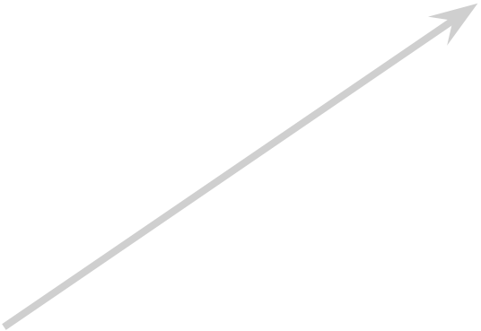





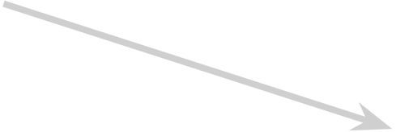




Asynchronous Update
Using different initial outputs, we can obtain the state transition diagram, in which the vectors [1 -1]^{T} and [-1 1]^{T} are the two equilibria of the system.
[1 -1]^{T}
[1 1]^{T}
[-1 -1]^{T}
[-1 1]^{T}

Slide 12
Synchronous Update
For the same initial vector [-1 -1]^{T}
we have y(¹⁾ = [ 1 1]^{T} and y(²⁾ = [ -1 -1]^{T} Same as initial output vector y⁽⁰⁾
The synchronous update produces a cycle of two states rather
than a single equilibrium state.
Synchronous update may cause the networks to converge either to fixed points or limit cycles.

Slide 13
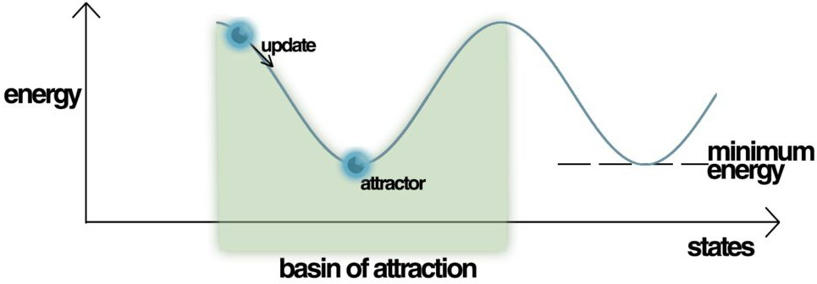
Energy
The network is characterized by an energy function to evaluate the stability property of a discrete Hopfield network.
Energy Landscape of a Hopfield Network, highlighting the current state of the network (up the hill), an attractor state to which it will eventually converge, i.e. a minimum energy level and a basin of attraction shaded in green.
Hopfield nets have a scalar value associated with each state of the network referred to as the "energy", E, of the network.

Slide 14
STABILITY PROPERTY
Energy function to characterize the behavior of the network:
n n n n
E = -½ ∑
i=1
∑ w_{ij} y_{i} y_{j} - ∑ x_{i} y_{i} + ∑ θ_{i} y_{i}
j=1 i=1 i=1 j≠i
In stable network the energy function decreases during change of state of any node.
Assume that node i changes state from y ^{(k)} to y ^{(k+1)}.
i i
So its output changes from +1 to –1 or vice versa.

Slide 15
Change in energy:
n
(k) _{+ x - θ ) (y} (k+1)_{- y} (k)₎
ΔE = E(y ^{(k+1)}) - E (y ^{(k)} ) = - ( ∑ w y
i i ij j
i i i i
j=1, j≠i
ΔE = - (net ) Δy where Δy = y ^{(k+1)} - y ^{(k)}; i i i i i
w_{ji} and w_{ii}=0
_{y} (k+1) _{= y} (k)_{; w =}
j j ij
Case I: If y ^{(k)} has changed from -1 to +1; i.e. (Δy = +2), then net
i i
i
must be positive and ΔE will be negative.
Case II: If y ^{(k)}
has changed from +1 to -1; i.e. (Δy = -2), then
i i
net_{i} must have been negative and ΔE will be again negative.
Case III: If y ^{(k)} has not changed (Δy = 0), so ΔE = 0.
Thus ΔE
≤ 0 always.
i i

Slide 16
Why RNN?
The idea behind RNNs is to make use of sequential information, present in the input, output, or in most general case both.
RNNs accept an input vector x and give an output vector y.
Crucially this output vector’s contents are influenced not only by the input you just fed in, but also on the entire history of inputs you’ve fed in the past.
In theory RNNs can make use of information
in arbitrarily long sequences, but in practice they are limited to looking back only a few steps.

Slide 17
Why RNN?
RNNs are called recurrent because they perform the same task for every element of a sequence, with the output being depended on the previous computations.
RNNs have a “memory” which captures information about what has been calculated so far.
To maintain word order
To share parameters across the sequence
To keep track of long term dependencies

Slide 18
RNNs as sequence Modeling
Speech Recognition: Input X is a speech signal transforms to a sentence, i.e. output Y is sequence of words.
Music generation: X may be an empty set, Y is a sequence of tunes of music.
Sentiment classification: X is the sentences, Y is review of a movie.
Video activity recognition: X is Frame of videos, Y is Interpretation
Name entity recognition: X is a sequence of words as sentence, Y is identification of people

Slide 19
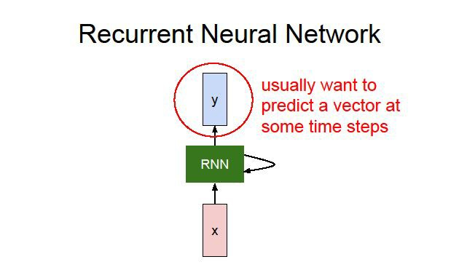
Recurrent Neural Network
Humans don’t start their thinking from scratch every second because thoughts have persistence.
In a traditional neural network we assume that all inputs (and outputs) are independent of each other.
RNNs address this issue with loops in them, allowing information to persist.
Supervised learning as label data is to be provided

Slide 20



when it is required to predict the next word of a sentence, the previous words are required and hence there is a need to remember the previous words.
Thus RNN came into existence, which solved this issue with the help of a Hidden Layer.
The main and most important feature of RNN is Hidden state, which remembers some information about a sequence.
h_{t} is current state, h_{t-1} is previous state and x_{t} is input state.
W_{hh} is weight at current neuron W_{xh} is weight at input neuron
y_{t} is output and W_{hy} is weight at output layer

Slide 21
Representing words
As a vocabulary or Dictionary of words of finite size.
One vector representation for each word, i.e. X^{<i>} of dimension say, 10,000
Provide input-output pair, but for each input, output dimension may be different.
One layer in the RNN for each word of a sentence.
There is many more sentences.

Slide 22
Forward Propagation
_{y}<t-1 >
_{y}<1>
_{y}<2>
y
^{w}ya
y
<t>
 | ^{w}ya
H I D D E N L A Y E R |  | _{a}<1>
 |  | ^{w}aa
^{w}ya
^{w}ya
_{a}<t-2>
^{w}aa
_{a}<0>
_{a}<t-1>
^{w}aa
^{w}aa
w
^{w}ax
w
ax
ax
^{w}ax
_{x}<1>
_{x}<T >
_{x}<2>
x
_{x}<t>
Activation value passes on next layer a^{<1>}
The parameters at each time step are shared

Slide 23
Forward Propagation
For each time step t, the activation a^{<t>} and the output y^{<t>} are expressed as:
a^{<0>} = 0, a^{<1>} = f (w a^{<0>} + w x^{<1>}): tanh/ReLU
w aa ax
y^{<1>} = h (w a^{<1>} ): sigmoid/softmax
ya
_{a}<t> _{= f (w a}<t-1> _{+ w x}<t>₎
w aa ax
y^{<t>} = h (w a^{<t>} )
ya
where W_{ax}, W_{aa}, W_{ya} are coefficients that are shared temporally and f_{w}, h activation functions.

Slide 24
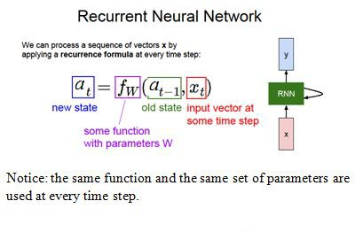
The weight matrices are filters that determine how much importance to accord to both the present input and the past hidden state.
The error they generate will return via backpropagation and be used to adjust their weights until error is not reduced further.

Slide 25
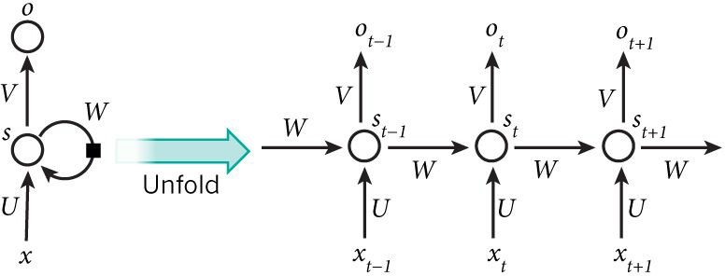
The network for the complete sequence
A recurrent neural network and the unfolding in time of the computation involved in its forward computation.
If the sequence we care about is a sentence of 5 words, the network would be unrolled into a 5-layer neural network, one layer for each word.

Slide 26
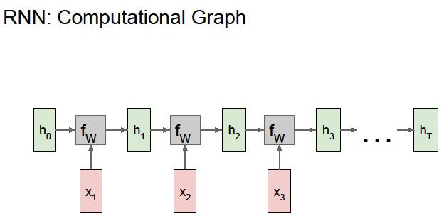
An unrolled Recurrent Neural Network
A chunk of neural network, A, looks at some input x_{t} and outputs a value h_{t}
A loop allows information to be passed from one step of the network to the next.
A RNN can be thought of as multiple copies of the same network, each passing a message to a successor.
This chain-like nature reveals that RNNs are intimately related to sequences and lists and the natural architecture of neural network to use for such data.

Slide 27
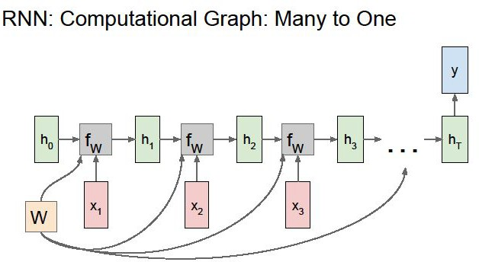
Sentiment classification

Slide 28
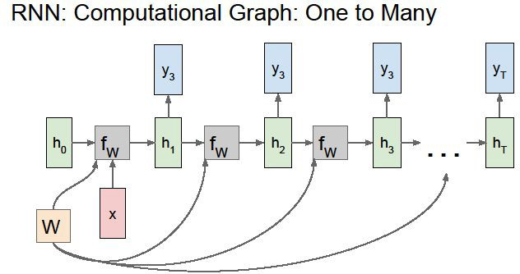
Music Generation

Slide 29
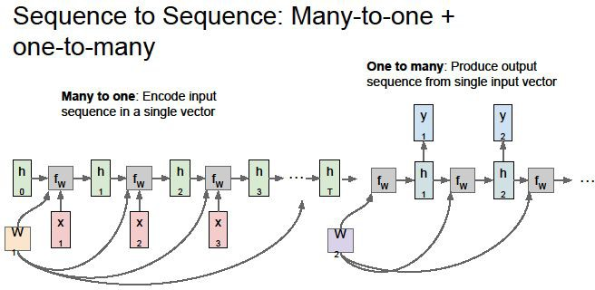
Name Entity Recognition

Slide 30

Loss function
In the case of a recurrent neural network, the loss function L of all time steps is defined based on the loss at every time step.
<t> <t>
L(y’, y) = ∑_{t=1 .. Ty} [L (y’ , y )]
Backpropagation through time is done at each point in time. At time step T, the derivative of the loss L with respect to weight matrix W is expressed as:

Slide 31
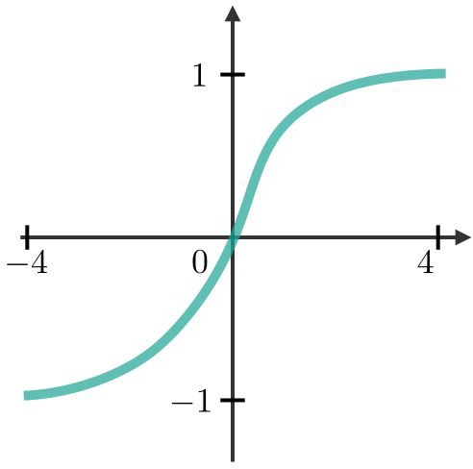
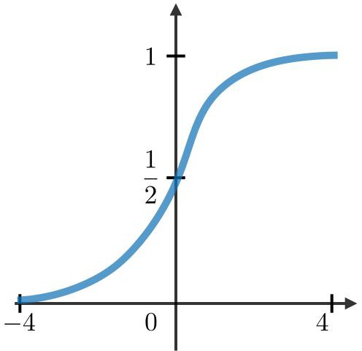
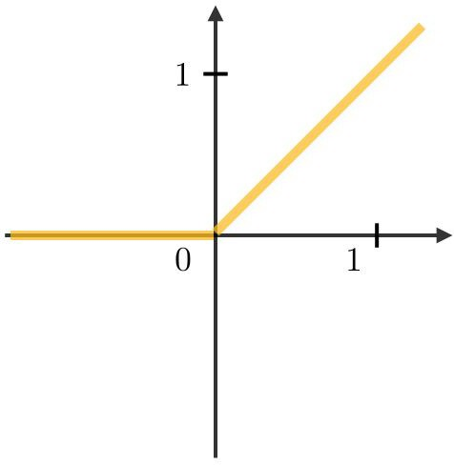



Activation functions
Sigmoid:
Tanh
ReLU

Slide 32
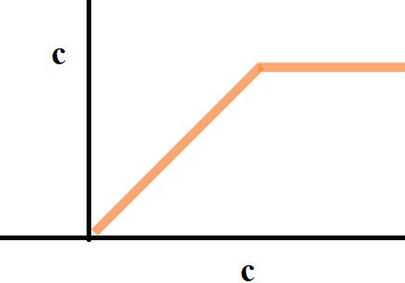
Issues with Backpropagation:
it is difficult to capture long term dependencies because of multiplicative gradient that exponentially decreasing/increasing with number of layers.
Gradient clipping is a technique used to cope with the exploding gradient problem.
||∇L|
By capping the maximum value for the gradient, this phenomenon is controlled in practice.
|
||∇L|
|

Slide 33
Training a RNN
RNN uses backpropagation algorithm applied at every time stamp, called backpropagation through time (BTT).
x_{t} is the input at time step t. For example, x₁ could be a one-hot vector corresponding to the second word of a sentence.
s_{t} is the hidden state at time step t.
It is the “memory” of the network, captures information about what happened in all the previous time steps.
s_{t} is calculated based on the previous hidden state and the input at the current step: s_{t} = g(Ux_{t} + Ws_{t-1}).

Slide 34
Training of RNN
The function g usually is a nonlinearity such as tanh or ReLU,
s_{t -1} required to calculate the first hidden state, typically initialized to all zeroes.
o_{t} is the output at step t. If we want to predict the next word in a sentence it would be a vector of probabilities across our vocabulary: o_{t} = softmax (Vs_{t})
The output at step o_{t} is calculated solely based on the memory at time t.

Slide 35
Training of RNN
Unlike a traditional neural network, which uses different parameters at each layer, a RNN shares the same parameters ( above) across all steps.
This reflects the fact that the same task is performed at each step, just with different inputs reduces the total number of parameters we need to learn.
Outputs may not be available at each time step, but depending on the task this may not be necessary.

Slide 36
For example, when predicting the sentiment of a sentence we may only care about the final output, not the sentiment
after each word.
Similarly, we may not need inputs at each time step.
The main feature of an RNN is its hidden state, which captures some information about a sequence.

Slide 37
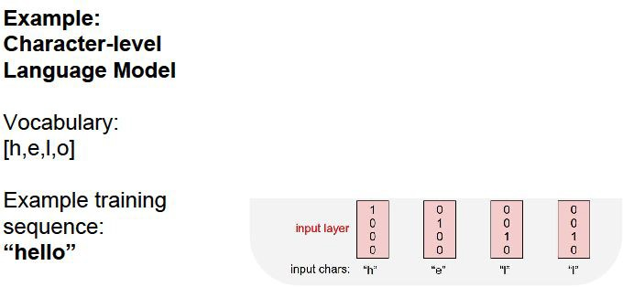
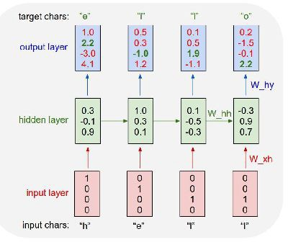

Slide 38
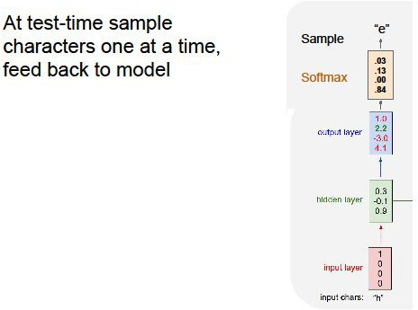
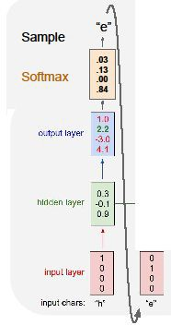
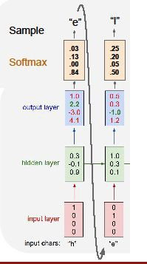
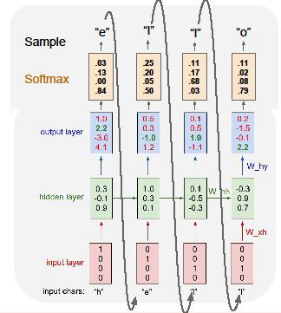

Slide 39
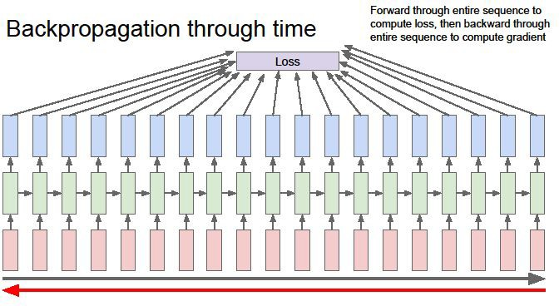

Slide 40
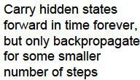
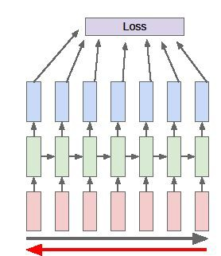

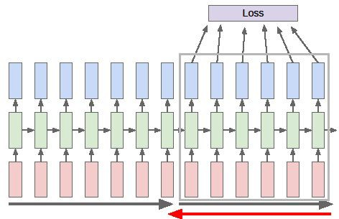
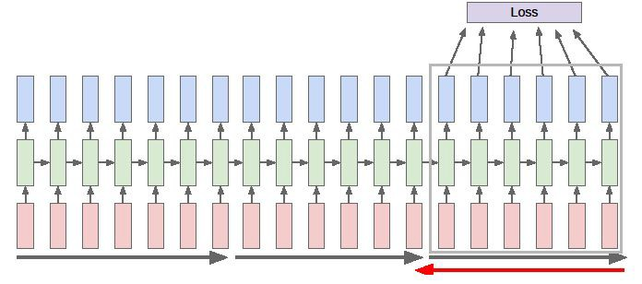

Slide 41
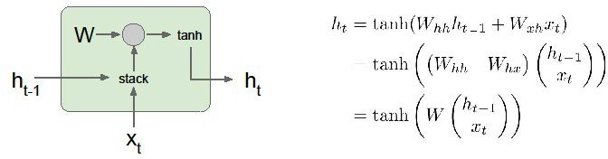
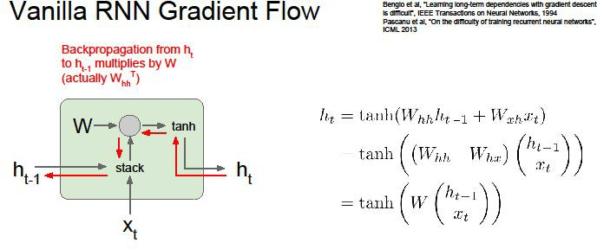

Slide 42
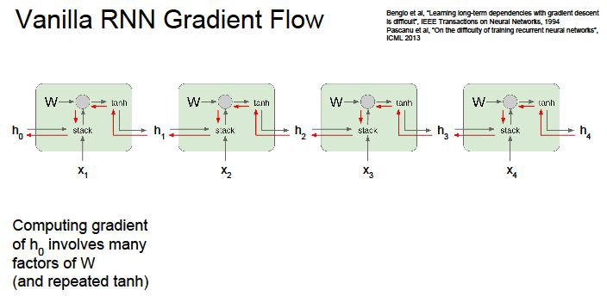
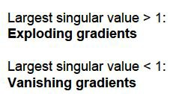
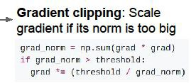

Sequential information is preserved in the recurrent network’s hidden state.
Correlations between events separated by many moments, and these correlations are called “long-term dependencies”.
An event downstream in time depends upon, and is a function of, one or more events that came before.

Slide 43
Limitation of RNN
Recurrent Neural Networks work just fine when dealing with short-term dependencies.
The colour of milk is ---
Nothing to do with the context of the statement.
The RNN need not to remember what was said before this, or what was its meaning.
Vanilla RNNs fail to understand the context behind an input.
Something that was said long before, cannot be recalled when making predictions in the present.

Slide 44

Problem of RNN
To make a proper prediction, the RNN needs to remember this context.
The relevant information may be separated from the point where it is needed, from the irrelevant data.
The reason behind this is the problem of Vanishing Gradient.

Slide 45
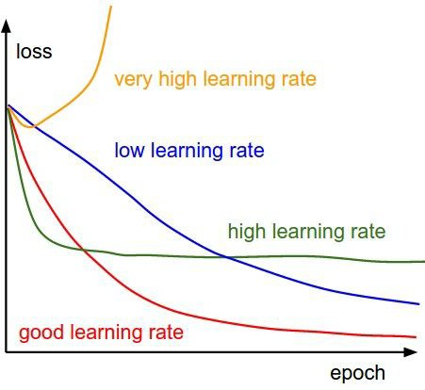
Variants of Gradient Descent algorithm- Vanilla Gradient Descent
Learning rate is a hyper-parameter

Slide 46
Long-Term Dependencies
RNN remembers things for just small durations of time, i.e. if we need the information after a small time it may be reproducible, but once a lot of words are fed in, this information gets lost somewhere.
In RNN there is no consideration for ‘important’ information and ‘not so important’ information.
This issue can be resolved using Long Short-Term Memory (LSTM) Networks.
LSTMs on the other hand, make small modifications to the information

Slide 47
Long Short Term Memory as Gated Cell
Information can be stored in, or read from a cell, much like data in a computer’s memory.
The cell makes decisions about what to store, and when to allow reads, writes and erases, via gates that open and close.
The core concept of LSTMs are the cell state, and its various gates.
The cell state act as a transport highway that transfers relative information all the way down the sequence chain.

Slide 48
LSTM (Long Short Term Memory)
LSTM (Long Short Term Memory) networks improve on this simple transformation and introduces additional gates and a cell state, such that it fundamentally addresses the problem of keeping or resetting context, across sentences and regardless of the distance between such context resets.
There are variants of LSTMs including GRUs that utilize the gates in different manners to address the problem of long term dependencies.

Slide 49
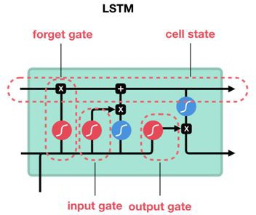

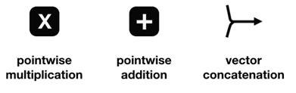
Cell State
Unlike the digital storage on computers, however, these gates are analog, implemented with element-wise multiplication by sigmoids, which are all in the range of 0-1.
Analog has the advantage over digital of being differentiable, and therefore suitable for backpropagation.

Slide 50
LSTMs
The cells learn when to allow data to enter, leave or be deleted through the iterative process of making guesses, backpropagating error, and adjusting weights via gradient descent.
LSTMs can selectively remember or forget things,composed of a cell, an input gate, an output gate and a forget gate.
The information at a particular cell state has three different dependencies.
The previous cell state
The previous hidden state
The input at the current time step
Addition, modification or removal of information as it flows through the different layers, thus able to forget and remember things selectively.

Slide 51
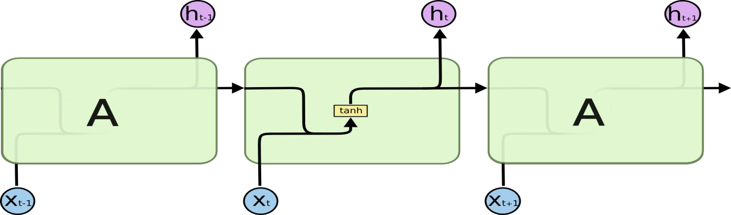
In standard RNNs:

Slide 52

The repeating module in an LSTM
LSTMs mechanisms: Forget, Input and Output.
A typical LSTM network is comprised of different memory blocks called cells, responsible for remembering things.
The expression long short-term refers to the fact that LSTM is a model for the short-term memory which can last for a long period of time.

Slide 53
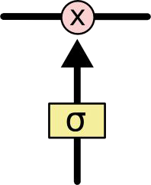
Long short-term memory
The sigmoid layer outputs values between zero and one, describing how much of each component should be let through.
A value of zero means “let nothing through,” while a value of one means “let everything through!”
The LSTM does have the ability to remove or add information to the cell state, carefully regulated by structures called gates.

Slide 54
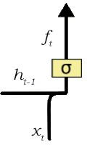
Forget Gate
An LSTM has three of these gates, to protect and control the cell state.
Gates are a way to let information through.
Forget Gate:
An LSTM is fed in, the following sentence: Mohan is a nice person. Tapas is an evil.
A forget gate is responsible for removing less or no longer required information from the cell state, via multiplication of a filter.

Slide 55
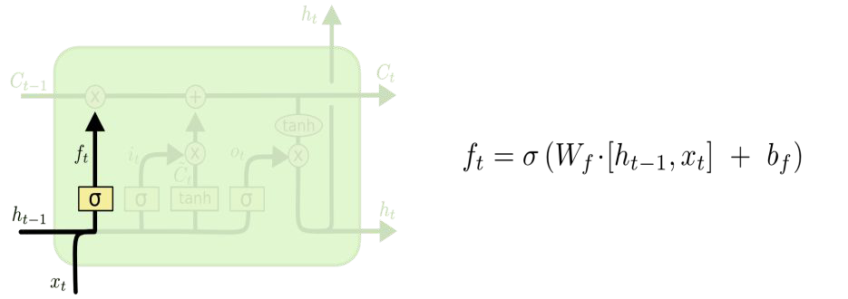
The first step in LSTM is to decide what information we’re going to throw away from the cell state.
This decision is made by a sigmoid layer called the “forget gate layer.”
It looks at h_{t−1} and x_{t}, and outputs a number [0, 1] for each number in the cell state C_{t−1}.
A 1 represents “completely keep this” while a 0 represents “completely get rid of this.”

Slide 56
Input Gate
The next step is to decide what new information we’re going to store in the cell state.
This has two parts. First, a sigmoid layer called the “input gate layer” decides which values we’ll update.
Next, a tanh layer creates a vector of new candidate values, C_{t}, that could be added to the state.
In the next step, we’ll combine these two to create an update to the state.

Slide 57
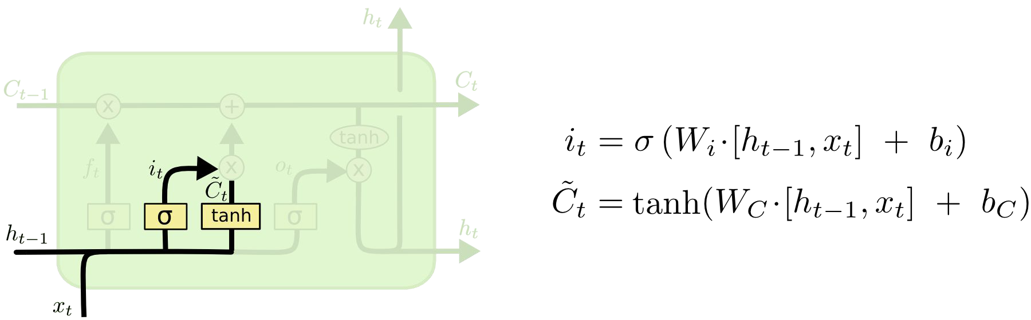
Input Gate
It’s now time to update the old cell state, C_{t−1}, into the new cell state C_{t}.

Slide 58
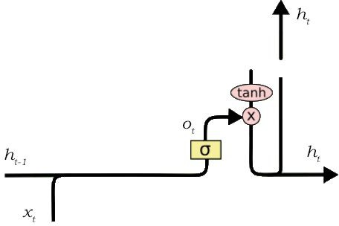
Output Gate
Its job is to selecting useful information from the current cell state and showing it out as an output via the output gate.
Creating a vector after applying tanh function to the cell state, thereby scaling the values to the range -1 to +1.
Making a filter using the values of h_{t-1} and x_{t}, such that it can regulate the values that need to be output from the created vector. This filter again employs a sigmoid function.
Multiplying the value of this regulatory filter to the vector created in step 1, and sending it out as a output and also to the hidden state of the next cell.

Slide 59
GRU
GRU can also be considered as a variation on the LSTM
To solve the vanishing gradient problem of a standard RNN, GRU uses, so called, update gate and reset gate.
These are two vectors which decide what information should be passed to the output.
The special thing about them is that they can be trained to keep information from long ago, without washing it through time or remove information which is irrelevant to the prediction.

Slide 60
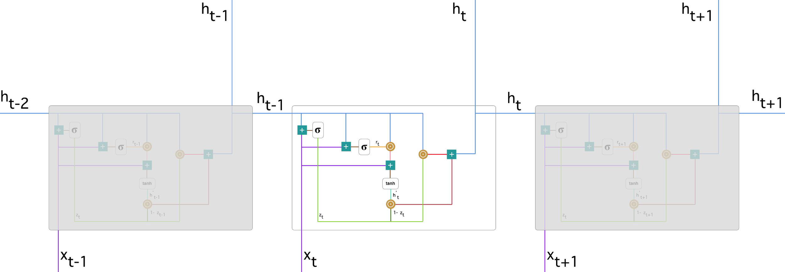
A single Unit

Slide 61
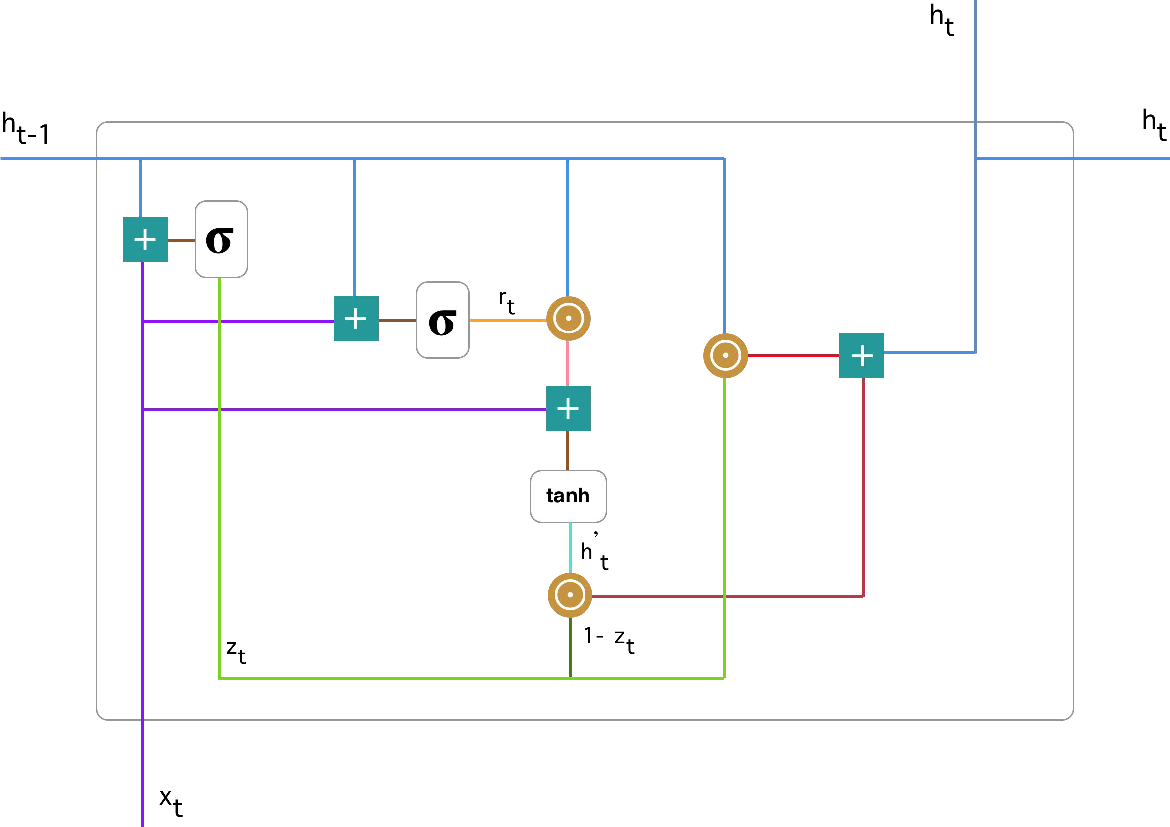
Gated Recurrent Unit

Slide 62

Update Gate
Calculating the update gate z_{t} for time step t using the formula:
The update gate helps the model to determine how much of the past information (from previous time steps) needs to be passed along to the future.
The model can decide to copy all the information from the past and eliminate the risk of vanishing gradient problem.

Slide 63
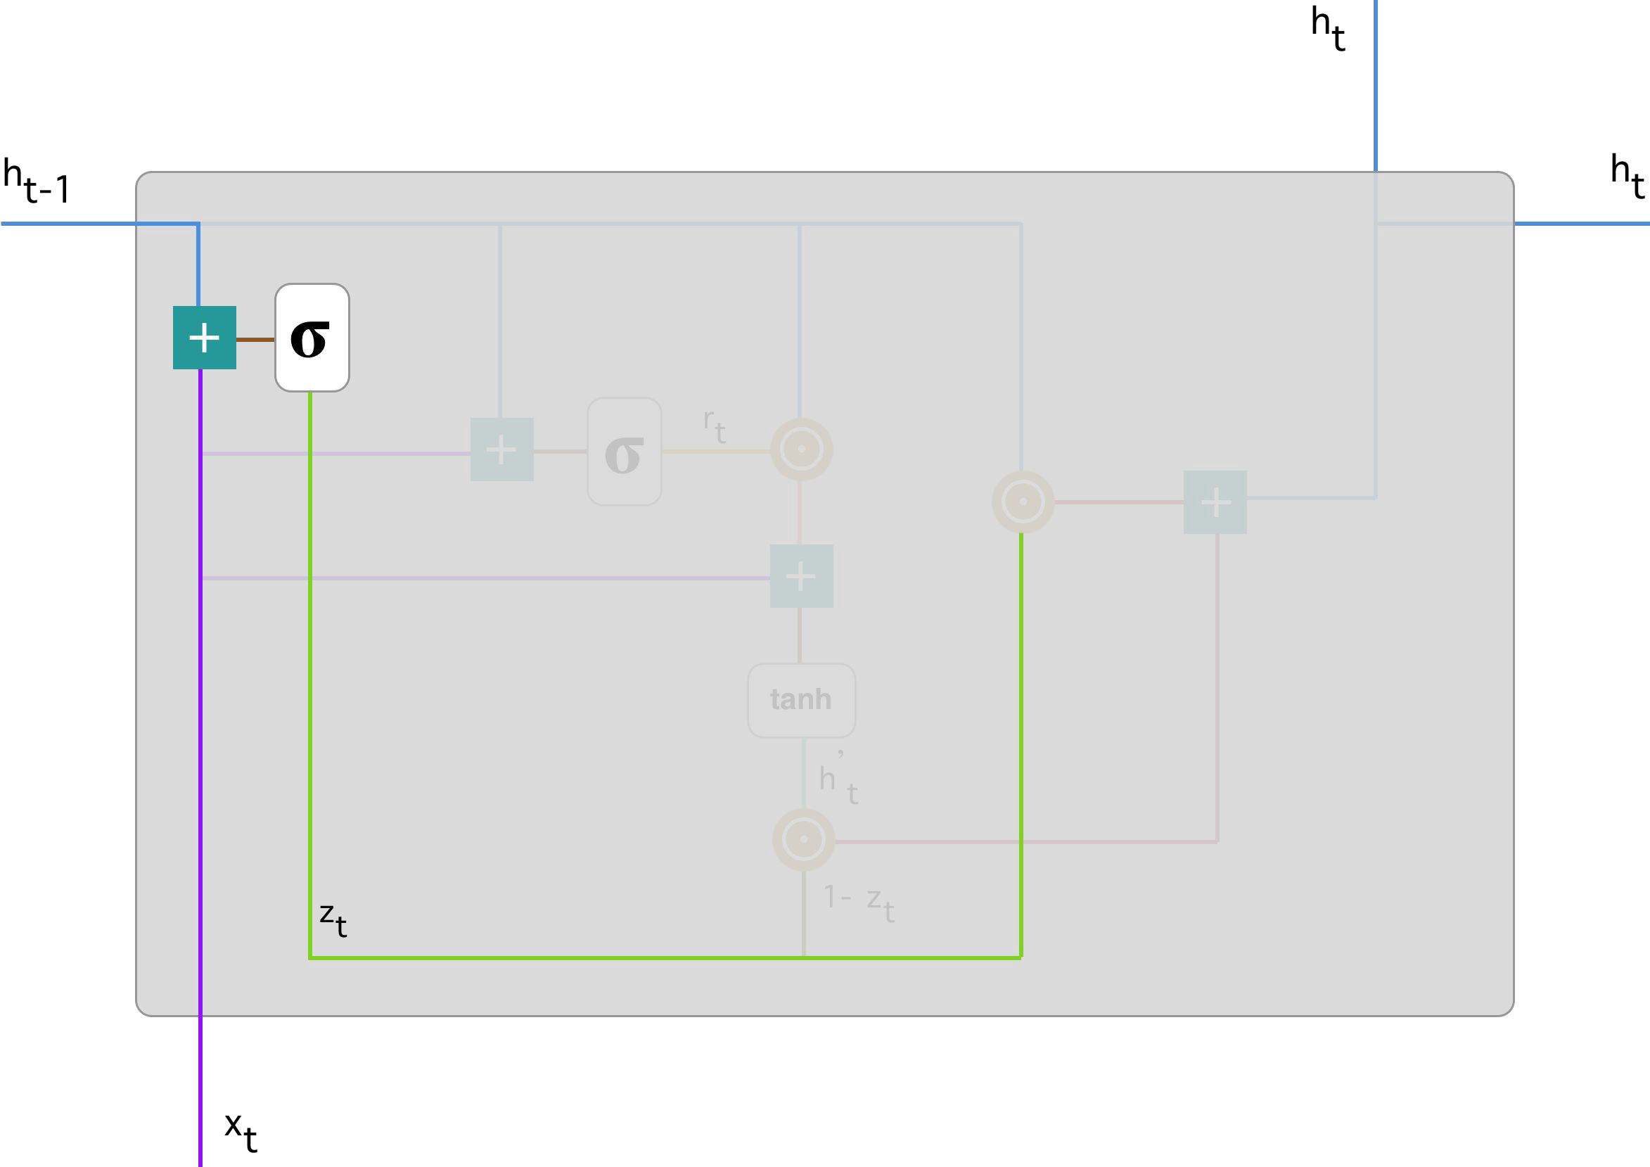
Update Gate

Slide 64
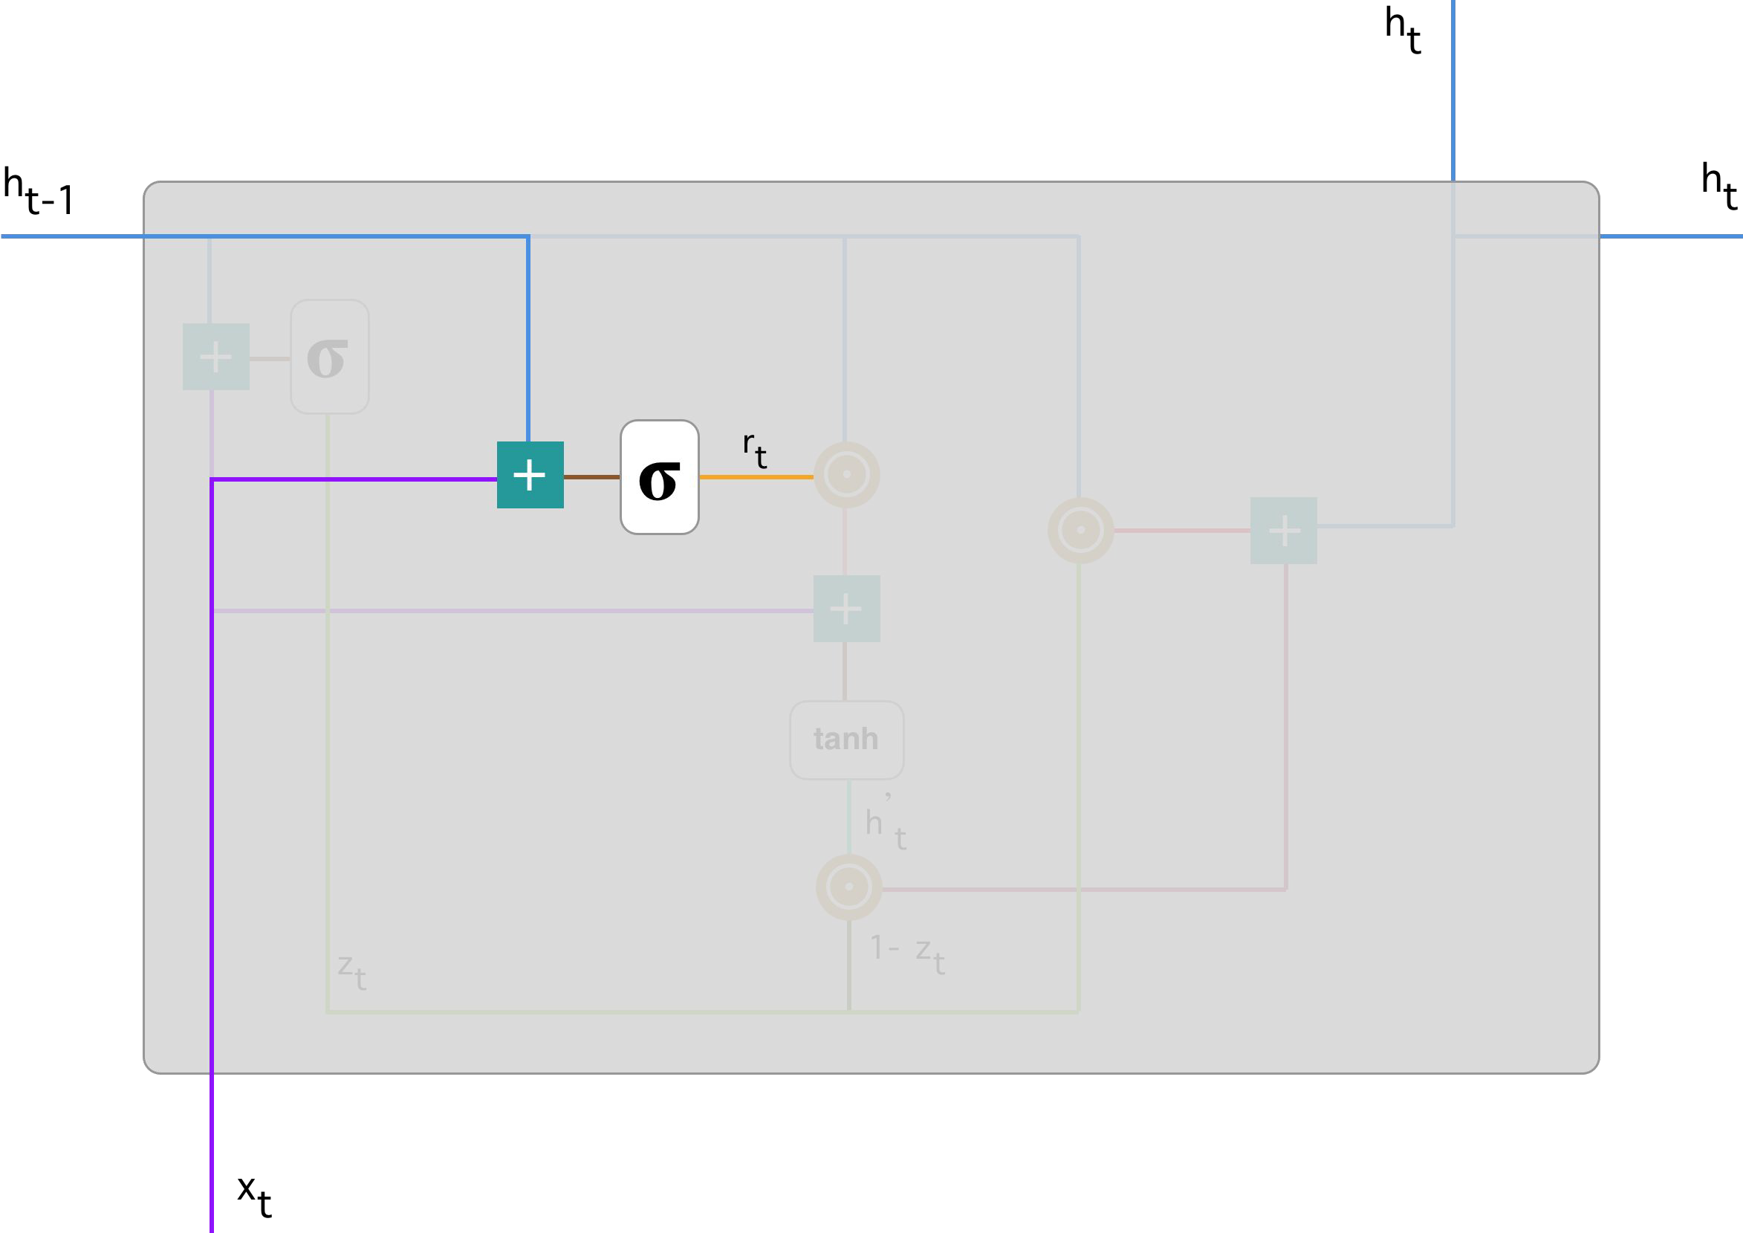

Reset gate
This gate is used to decide how much of the past information to forget.

Slide 65

Current memory content
New memory content which will use the reset gate to store the relevant information from the past.
Hadamard product between the reset gate r_{t} and Uh_{(t-1).} determine what to remove from the previous time steps.

Slide 66
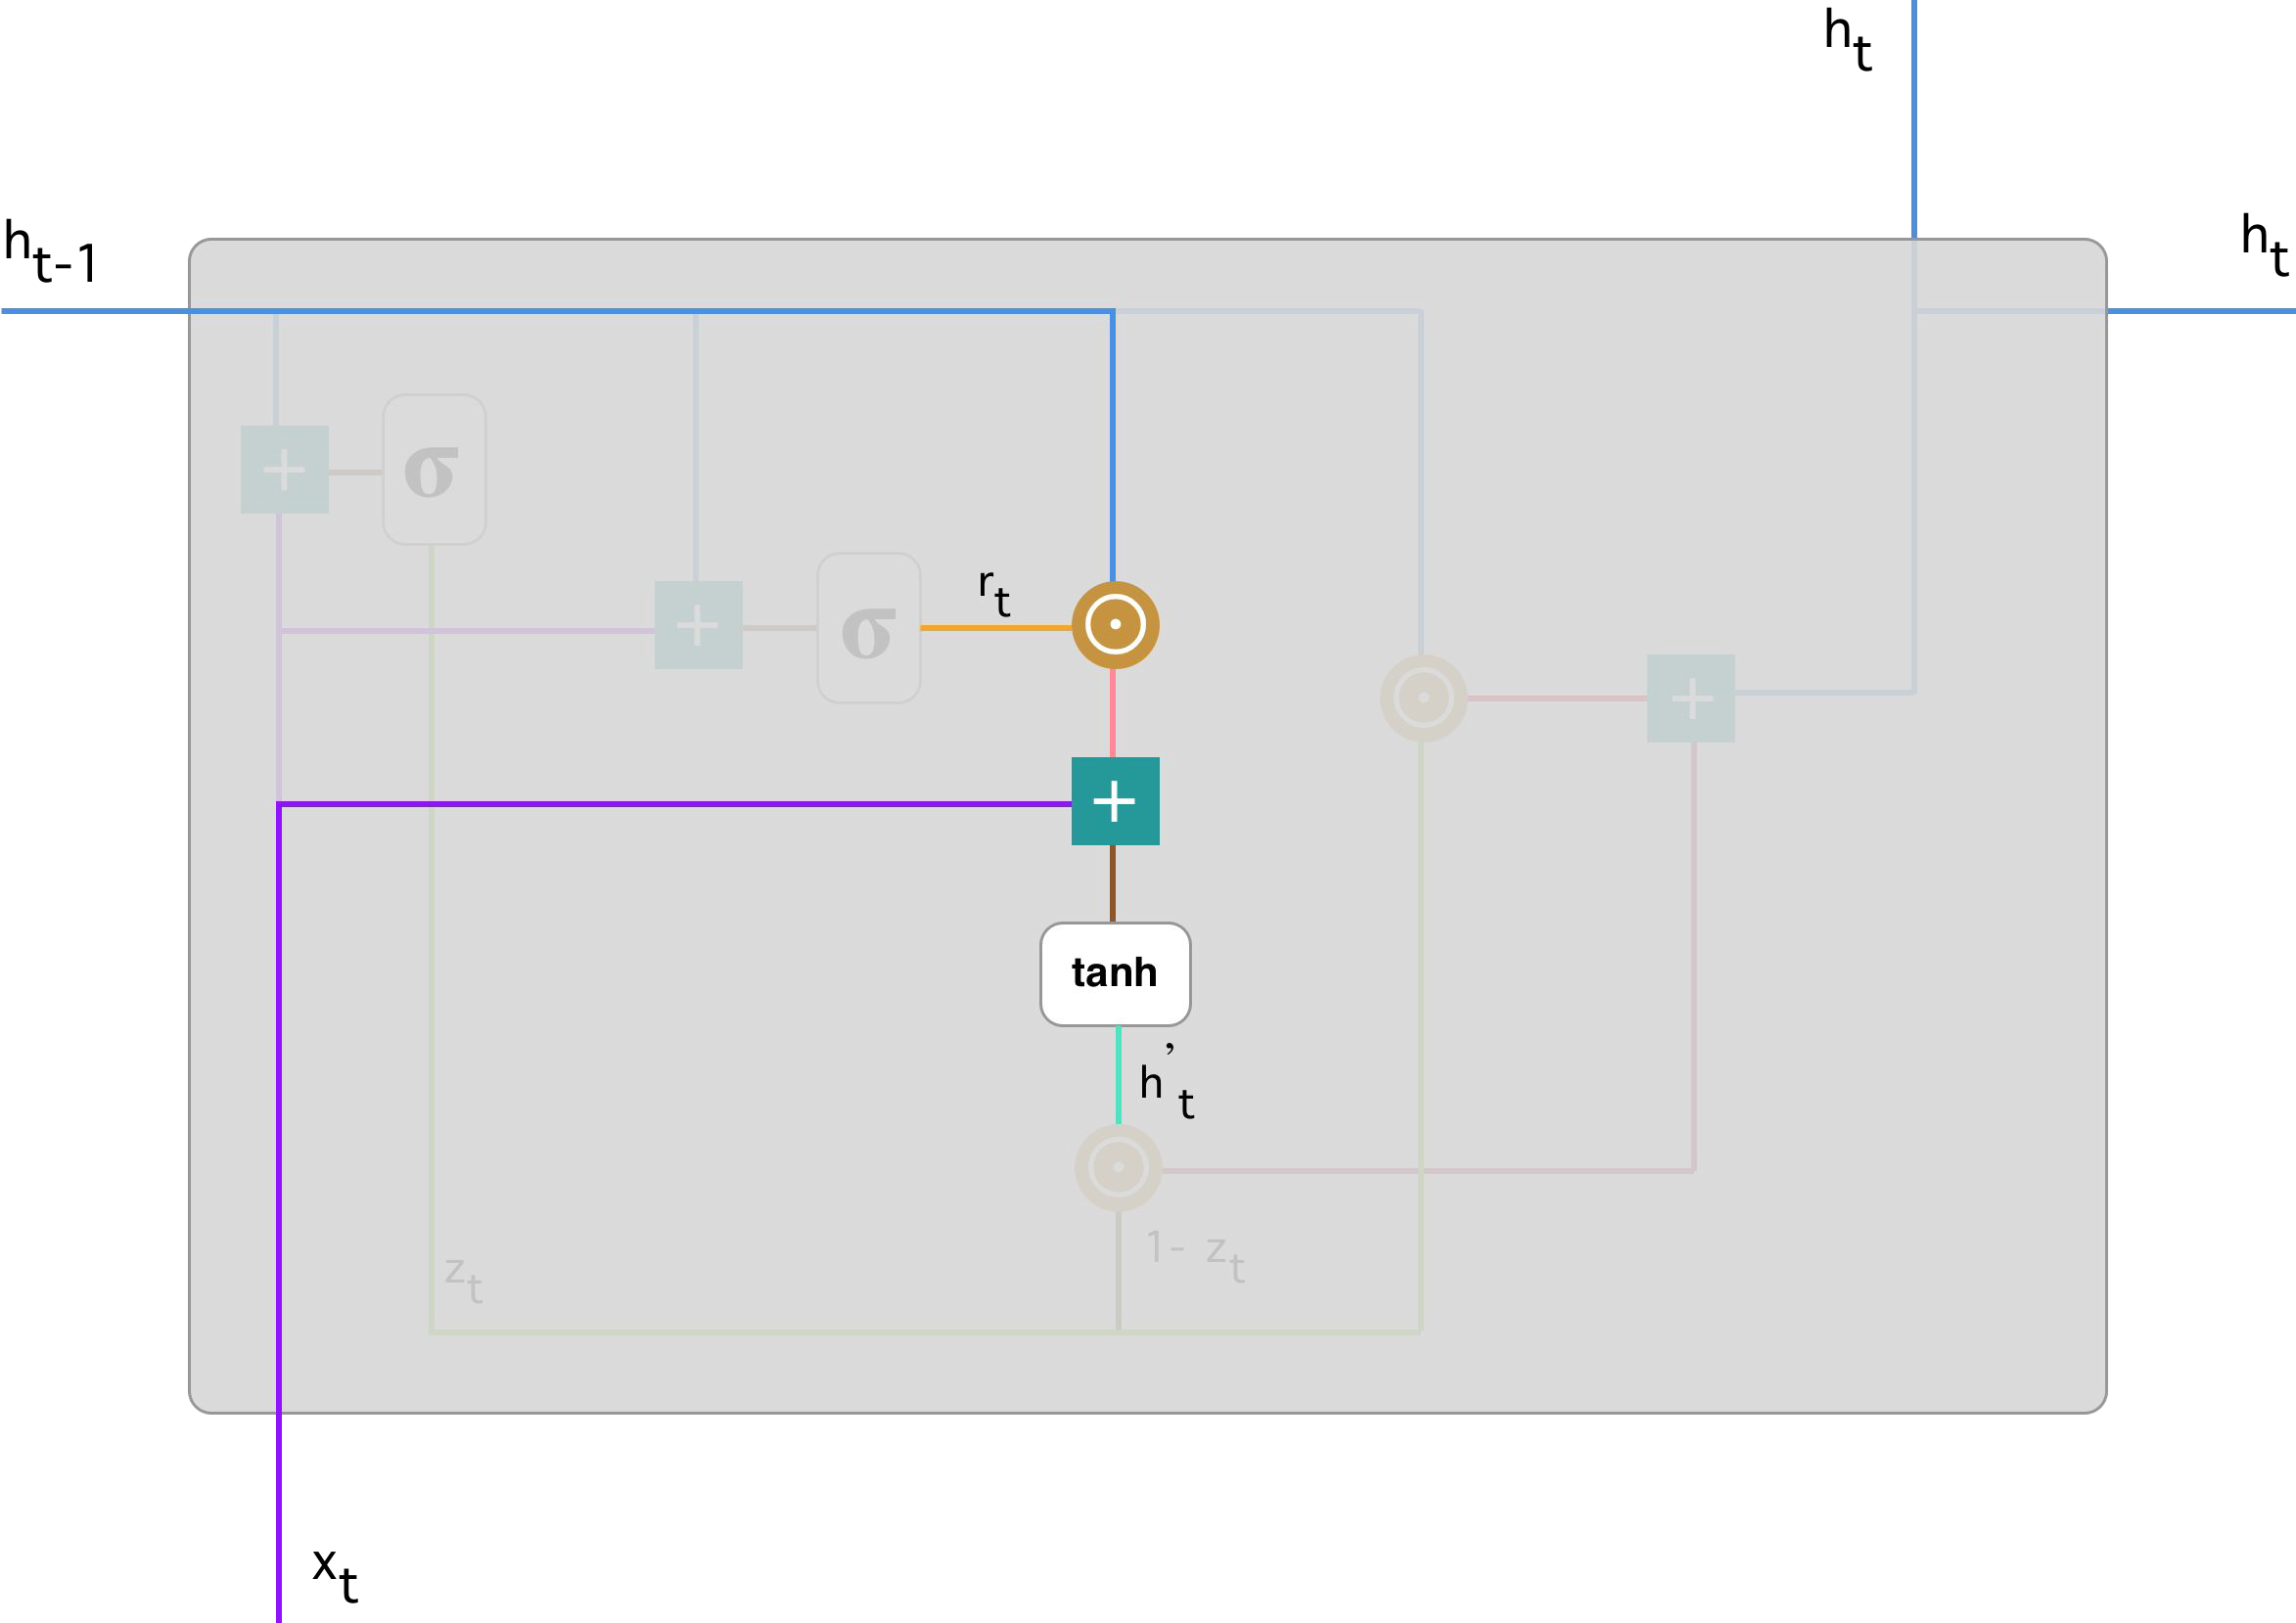
Current memory content

Slide 67

Final memory at current time step
As a last step, the network needs to calculate h_{t} — vector which holds information for the current unit and passes it down to the network.
In order to do that the update gate is needed, which determines what to collect from the current memory content — h’ _{t} and what from the previous steps — h _{(t-1)}

Slide 68
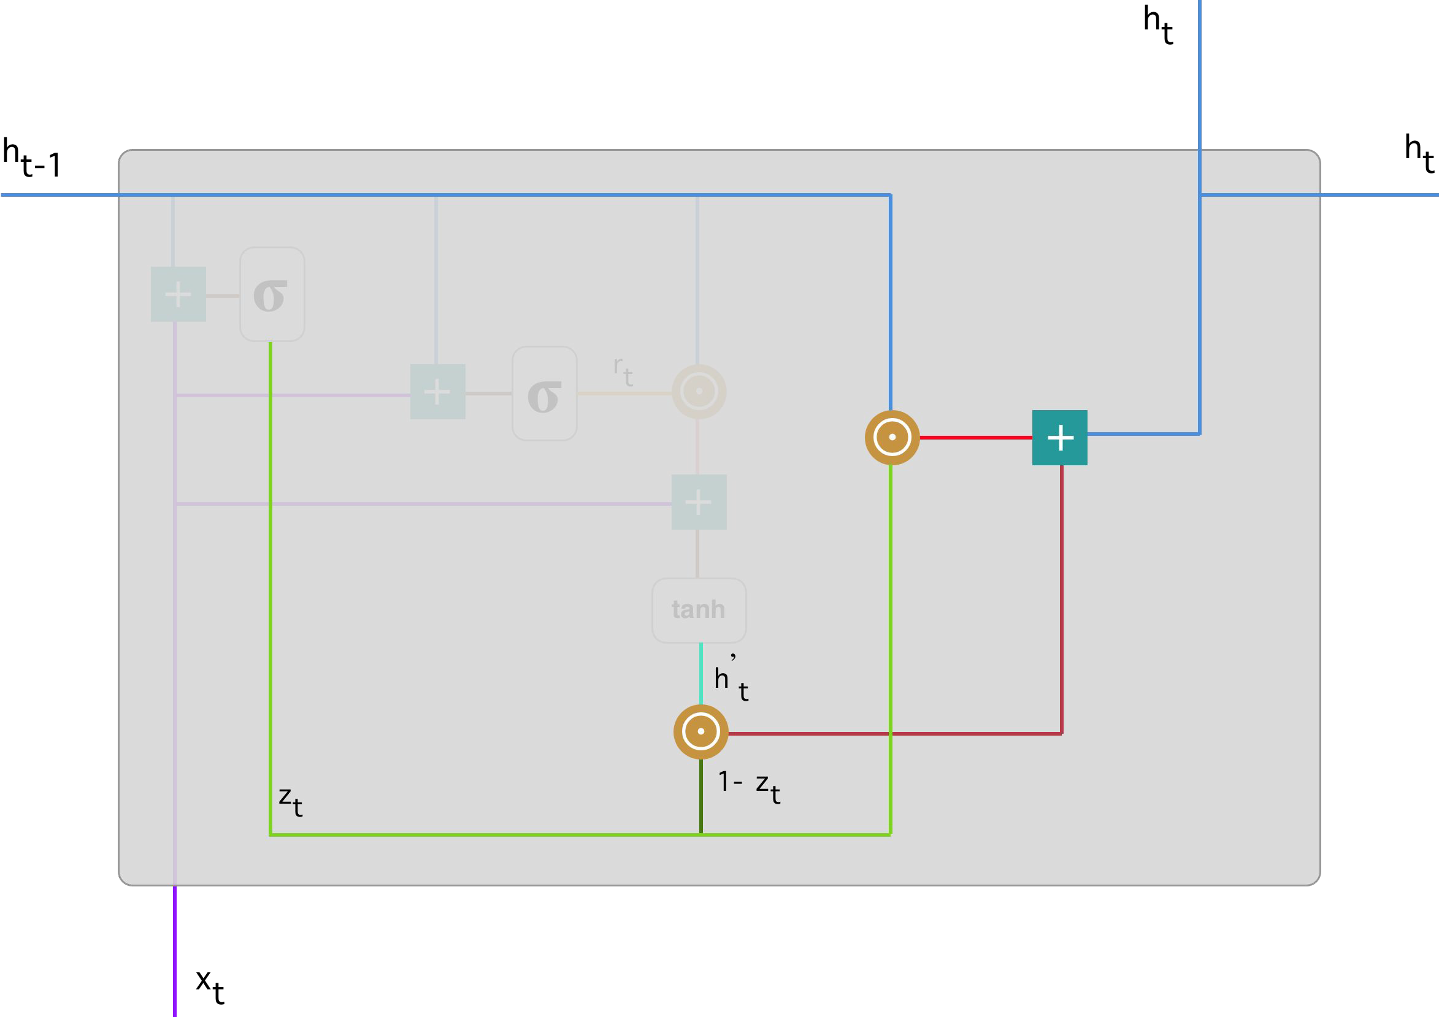

Slide 69
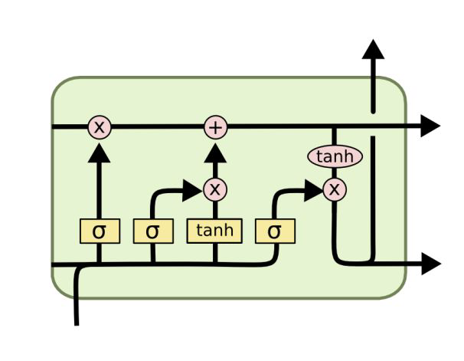
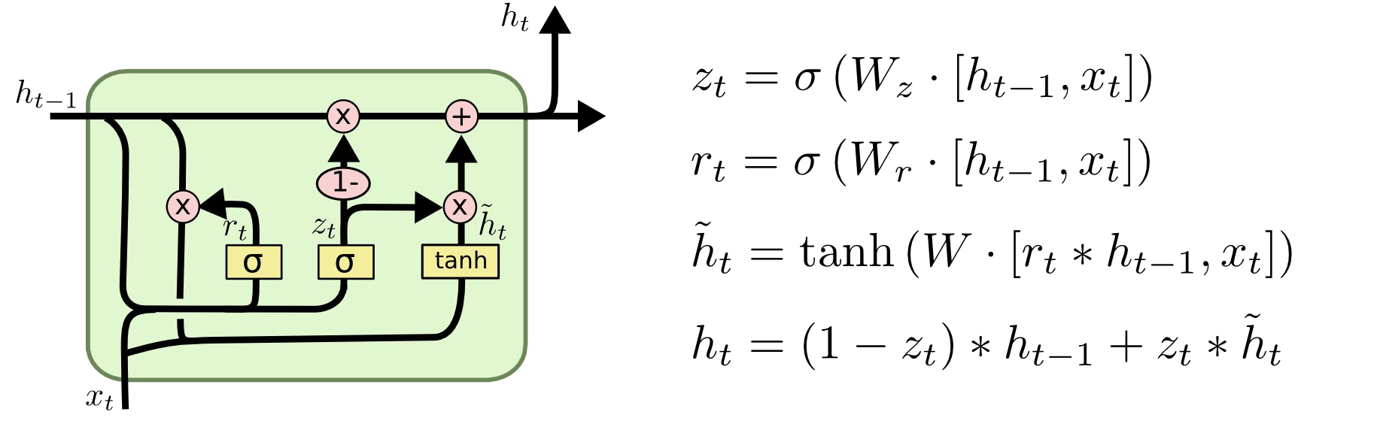


GRU – gated recurrent unit
(more compression)
LSTM
reset gate
Update gate
The model is not washing out the new input every single time but keeps the relevant information and passes it down to the next time steps of the network.
X,*: element-wise

Slide 70
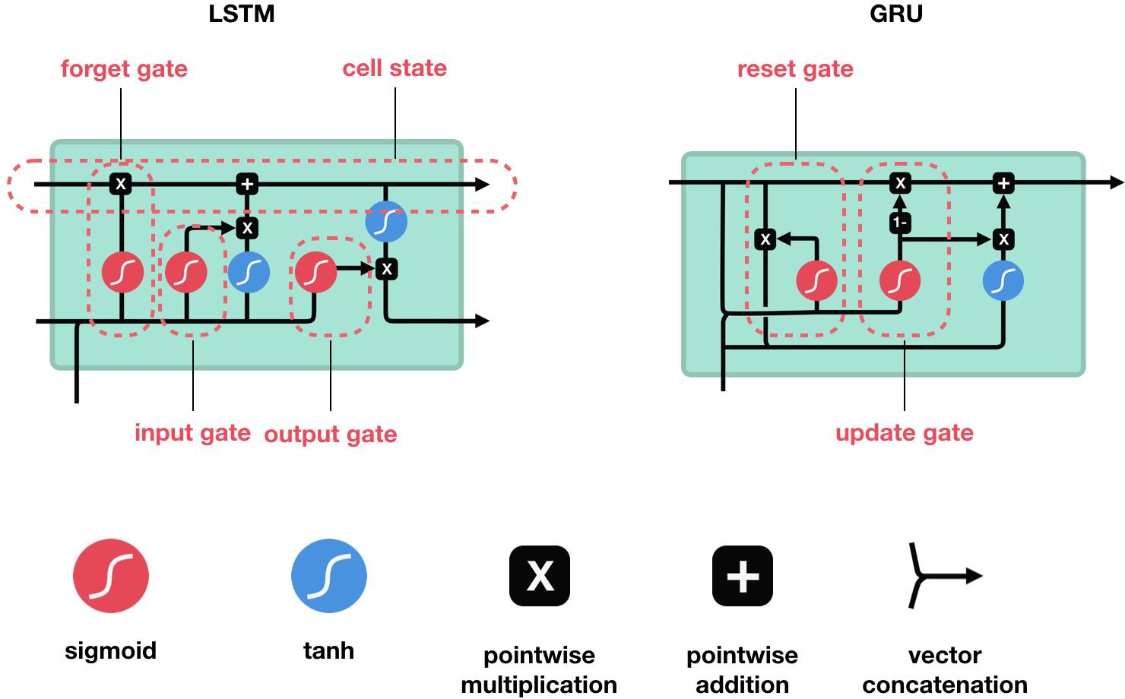

Slide 71
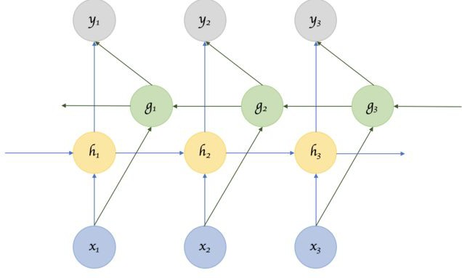
Variants of RNNs
Bidirectional (BRNN)

Slide 72
Bidirectional (BRNN)
Sometimes it’s not just about learning from the past to predict the future, but we also need to look into the future to fix the past.
In speech recognition and handwriting recognition tasks, where there could be considerable ambiguity given just one part of the input.
We often need to know what’s coming next to better understand the context and detect the present.
The obvious challenge of how much into the future we need to look into, because if we have to wait to see all inputs then the entire operation will become costly.

Slide 73
Word Embeddings
Word2vec is a framework aimed at learning word embeddings by estimating the likelihood that a given word is surrounded by other words.
Popular models include skip-gram, negative sampling and CBOW.
Skip-gram: The skip-gram word2vec model is a supervised learning task that learns word embeddings by assessing the likelihood of any given target word t happening with a context word c.

Slide 74
t-SNE (t-distributed Stochastic Neighbor Embedding) is a technique aimed at reducing high-dimensional embeddings into a lower dimensional space.
In practice, it is commonly used to visualize word vectors in the 2D space.

Slide 75
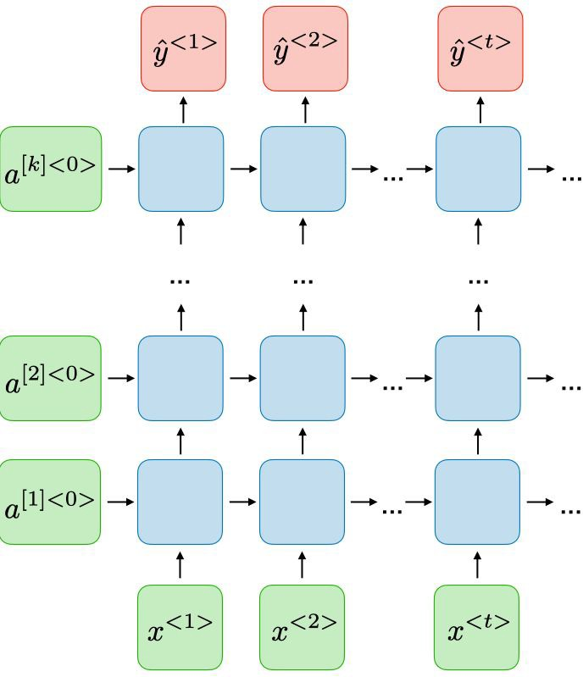
Deep (DRNN)

Slide 76
Attention model
This model allows an RNN to pay attention to specific parts of the input that is considered as being important, which improves the performance of the resulting model in practice.

Slide 77
Encoder Decoder Sequence to Sequence RNNs
The basic idea is that there are two RNNs, one an encoder that keeps updating its hidden state and produces a final single “Context” output.
This is then fed to the decoder, which translates this context to a sequence of outputs.
The length of the input sequence and the length of the output sequence need not necessarily be the same.

Slide 78


Slide 79
RNNs in NLP: Language Modeling and Generating Text
Given a sequence of words we want to predict the probability of each word given the previous words.
Language Models allow us to measure how likely a sentence is, an important input for Machine Translation.
Language Modeling being able to predict the next word as
a generative model, which allows us to generate new text by sampling from the output probabilities.

Slide 80
Machine Translation
Machine Translation is similar to language modeling in that our input is a sequence of words in our source language (e.g. German).
We want to output a sequence of words in our target language (e.g. English).
A key difference is that our output only starts after we have seen the complete input, because the first word of our translated sentences may require information captured from the complete input sequence.

Slide 81
THANK YOU

